Slide 1

Computer Networks
By
Dr. Kanchan Shende

Slide 2
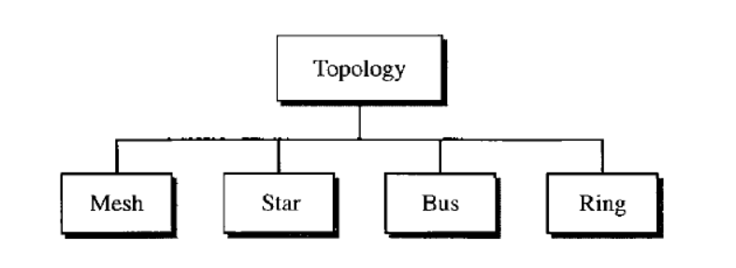
Network Topologies
Topology :
The topology of a network is the geometric representation of the relationship of all the links and linking devices (usually called nodes) to one another.
There are four basic topologies : mesh, star, bus, and ring
SoCS, MIT-WPU

Slide 3
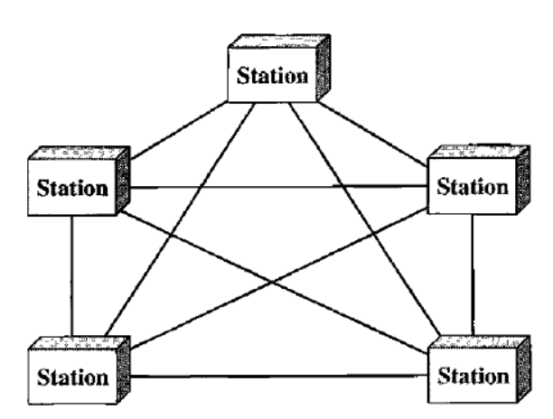
Conti…
Mesh Topology:
In a mesh topology, every device has a dedicated point-to-point link to every other device.
The term dedicated means that the link carries traffic only between the two devices it connects.
SoCS, MIT-WPU

Slide 4
Conti…
A mesh offers several advantages over other network topologies:
The use of dedicated links guarantees that each connection can carry its own data load, thus eliminating the traffic problems that can occur when links must be shared by multiple devices.
A mesh topology is robust. If one link becomes unusable, it does not incapacitate the entire system.
SoCS, MIT-WPU

Slide 5
Conti…
3. There is the advantage of privacy or security. When every message travels along a dedicated line, only the intended recipient sees it. Physical boundaries prevent other users from gaining access to messages.
4. point-to-point links make fault identification and fault isolation easy
SoCS, MIT-WPU

Slide 6
Conti…
The main disadvantages of a mesh are related to the amount of cabling and the number of I/O ports required:
1. Because every device must be connected to every other device, installation and reconnection are difficult.
2. The sheer bulk of the wiring can be greater than the available space (in walls, ceilings, or floors) can accommodate.
3. The hardware required to connect each link (I/O ports and cable) can be prohibitively expensive.
SoCS, MIT-WPU

Slide 7
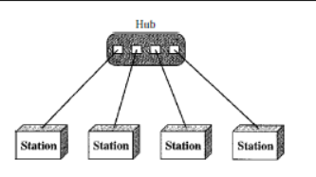
Conti…
Star Topology:
In a star, each device needs
only one link and one I/O port to connect it to any number of others.
This factor also makes it easy to install and reconfigure.
SoCS, MIT-WPU

Slide 8
Conti…
Advantage of Star Topology:
Robustness: If one link fails, only that link is affected. All other links remain active. This factor also lends itself to easy fault identification and fault isolation.
As long as the hub is working, it can be used to monitor link problems and bypass defective links.
SoCS, MIT-WPU

Slide 9
Conti…
Disadvantage of Star Topology:
Dependency of the whole topology on one single point, the hub. If the hub goes down, the whole system is dead.
Each node must be linked to a central hub. For this reason, often more cabling is required in a star than in some other topologies (such as ring or bus).
SoCS, MIT-WPU

Slide 10
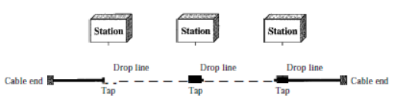
Conti…
Bus Topology:
SoCS, MIT-WPU

Slide 11
Conti…
Nodes are connected to the bus cable by drop lines and taps.
A drop line is a connection running between the device and the main cable.
A tap is a connector that either splices into the main cable or punctures the sheathing of a cable to create a contact with the metallic core.
SoCS, MIT-WPU

Slide 12
Conti…
Advantages of a bus topology
A bus topology include ease of installation.
Backbone cable can be laid along the most efficient path, then connected to the nodes by drop lines of various lengths. In this way, a bus uses less cabling than mesh or star topologies.
SoCS, MIT-WPU

Slide 13
Conti…
Disadvantages of a bus topology
Difficult reconnection and fault isolation.
A bus is usually designed to be optimally efficient at installation. It can therefore be difficult to add new devices.
Signal reflection at the taps can cause degradation in quality.
A fault or break in the bus cable stops all transmission, even between devices on the same side of the problem.
SoCS, MIT-WPU

Slide 14
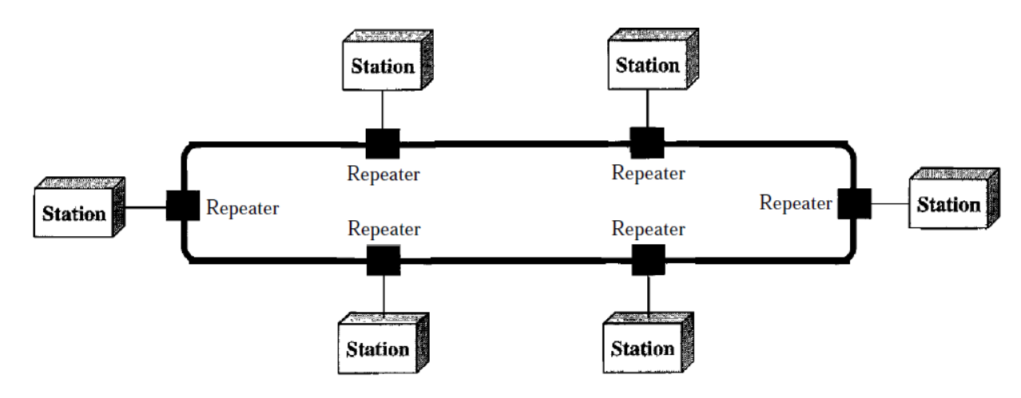
Conti…
Ring Topology:
SoCS, MIT-WPU

Slide 15
Conti…
Each device is linked to only its immediate neighbors (either physically or logically). To add or delete a device requires changing only two connections.
Fault isolation is simplified. Generally in a ring, a signal is circulating at all times. If one device does not receive a signal within a specified period, it can issue an alarm. The alarm alerts the network operator to the problem and its location.
SoCS, MIT-WPU

Slide 16
Conti…
Disadvantages of Ring Topology:
Unidirectional traffic
In a simple ring, a break in the ring (such as a disabled station) can disable the entire network. This weakness can be solved by using a dual ring or a switch capable of closing off the break.
SoCS, MIT-WPU

Slide 17
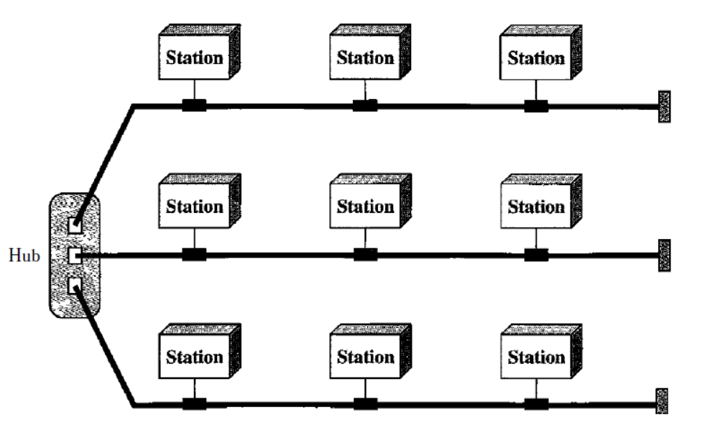
Conti…
Hybrid Topology:
A network can be hybrid. For example, we can have a main star topology
with each branch connecting several stations in a bus topology
SoCS, MIT-WPU

Slide 18
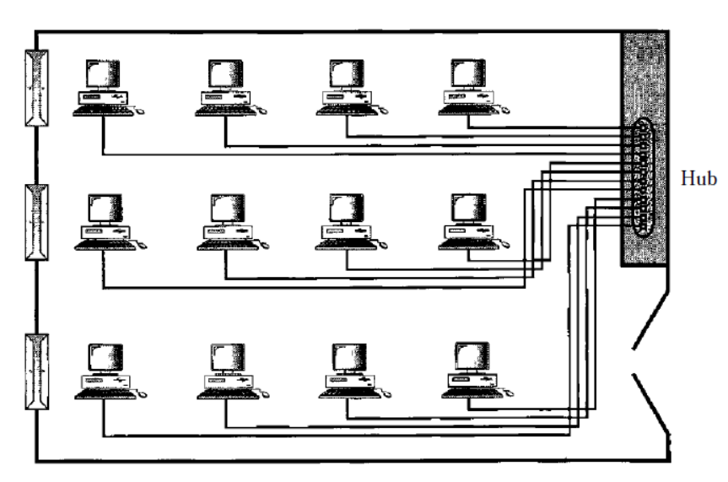
Categories of Networks :LAN, WAN, MAN protocols and standard
Local Area Network (LAN):
A local area network (LAN) is usually privately owned and links the devices in a single office, building, or campus.
Depending on the needs of an organization and the type of technology used,
SoCS, MIT-WPU

Slide 19
Conti…
LANs are designed to allow resources to be shared between personal computers or workstations.
The resources to be shared can include hardware (e.g., a printer), software (e.g., an application program), or data.
LANs are distinguished from other types of networks by their transmission media and topology. In general, a given LAN will use only one type of transmission medium.
The most common LAN topologies are bus, ring, and star.
SoCS, MIT-WPU

Slide 20
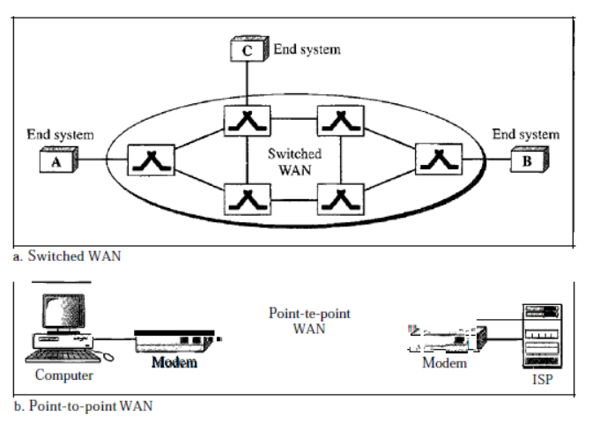
Conti…
Wide Area Network (WAN):
A wide area network (WAN) provides long-distance transmission of data, image, audio, and video information over large geographic areas that may comprise a country, a continent, or even the whole world.
SoCS, MIT-WPU

Slide 21
Conti…
A WAN can be as complex as the backbones that connect the Internet or as simple as a dial-up line that connects a home computer to the Internet.
The switched WAN connects the end systems, which usually comprise a router (internetworking connecting device) that connects to another LAN or WAN.
The point-to-point WAN is normally a line leased from a telephone or cable TV provider that connects a home computer or a small LAN to an Internet service provider (lSP).
SoCS, MIT-WPU

Slide 22
Conti…
Metropolitan Area Networks (MAN):
Metropolitan Area Network (MAN) is a network with a size between a LAN and a WAN.
It normally covers the area inside a town or a city. It is designed for customers who need a high-speed connectivity, normally to the Internet, and have endpoints spread over a city or part of city.
Example : telephone company network, cable TV network
SoCS, MIT-WPU

Slide 23
Protocols and Standard
Protocols:
Protocol is a set of rules that govern data communications. A protocol defines what is communicated, how it is communicated, and when it is communicated.
The key elements of a protocol are syntax, semantics, and timing.
SoCS, MIT-WPU

Slide 24
Conti…
Syntax
The term syntax refers to the structure or format of the data, meaning the order in which they are presented.
For example, a simple protocol might expect the first 8 bits of data to be the address of the sender, the second 8 bits to be the address of the receiver, and the rest of the stream to be the message itself
SoCS, MIT-WPU

Slide 25
Conti…
Semantics
The word semantics refers to the meaning of each section of bits.
How is a particular pattern to be interpreted, and what action is to be taken based on that interpretation?
For example, does an address identify the route to be taken or the final destination of the message?
SoCS, MIT-WPU

Slide 26
Conti…
Timing
The term timing refers to two characteristics: when data should be sent and how fast they can be sent.
For example, if a sender produces data at 100 Mbps but the receiver can process data at only 1 Mbps, the transmission will overload the receiver and some data will be lost.
SoCS, MIT-WPU

Slide 27
Conti…
Standards
Standards are essential in creating and maintaining an open and competitive market for equipment manufacturers and in guaranteeing national and international interoperability of data and telecommunications technology and processes.
Standards provide guidelines to manufacturers, vendors, government agencies, and other service providers to ensure the kind of interconnectivity necessary in today's marketplace and in international communications.
SoCS, MIT-WPU

Slide 28
Conti…
Data communication standards fall into two categories: de facto (meaning "by fact" or "by convention") and de jure (meaning "by law" or "by regulation").
De facto:
Standards that have not been approved by an organized body but have been adopted as standards through widespread use are de facto standards.
De facto standards are often established originally by manufacturers who seek to define the functionality of a new product or technology.
SoCS, MIT-WPU

Slide 29
Conti…
De jure:
Those standards that have been legislated by an officially recognized body are de jure standards.
SoCS, MIT-WPU

Slide 30
Practice Questions
Identify the five components of a data communications system.
What are the advantages of distributed processing?
What are the three criteria necessary for an effective and efficient network?
What are the advantages of a multipoint connection over a point-to-point connection?
Categorize the four basic topologies in terms of line configuration.
What is the difference between half-duplex and full-duplex transmission modes?
Name the four basic network topologies, and cite an advantage of each type.
For n devices in a network, what is the number of cable links required for a mesh, ring, bus, and star topology?
What are some of the factors that determine whether a communication system is a LAN or WAN?
Why are protocols needed?
Why are standards needed?
SoCS, MIT-WPU

